Slide 1

Analytics Platform Feb Update
Biometrics & Profiling Centre of Expertise (B&P CoE)
Official Closed (Non-Sensitive)
Correct as at 05 Feb 2025

Slide 2
Timeline

Slide 3
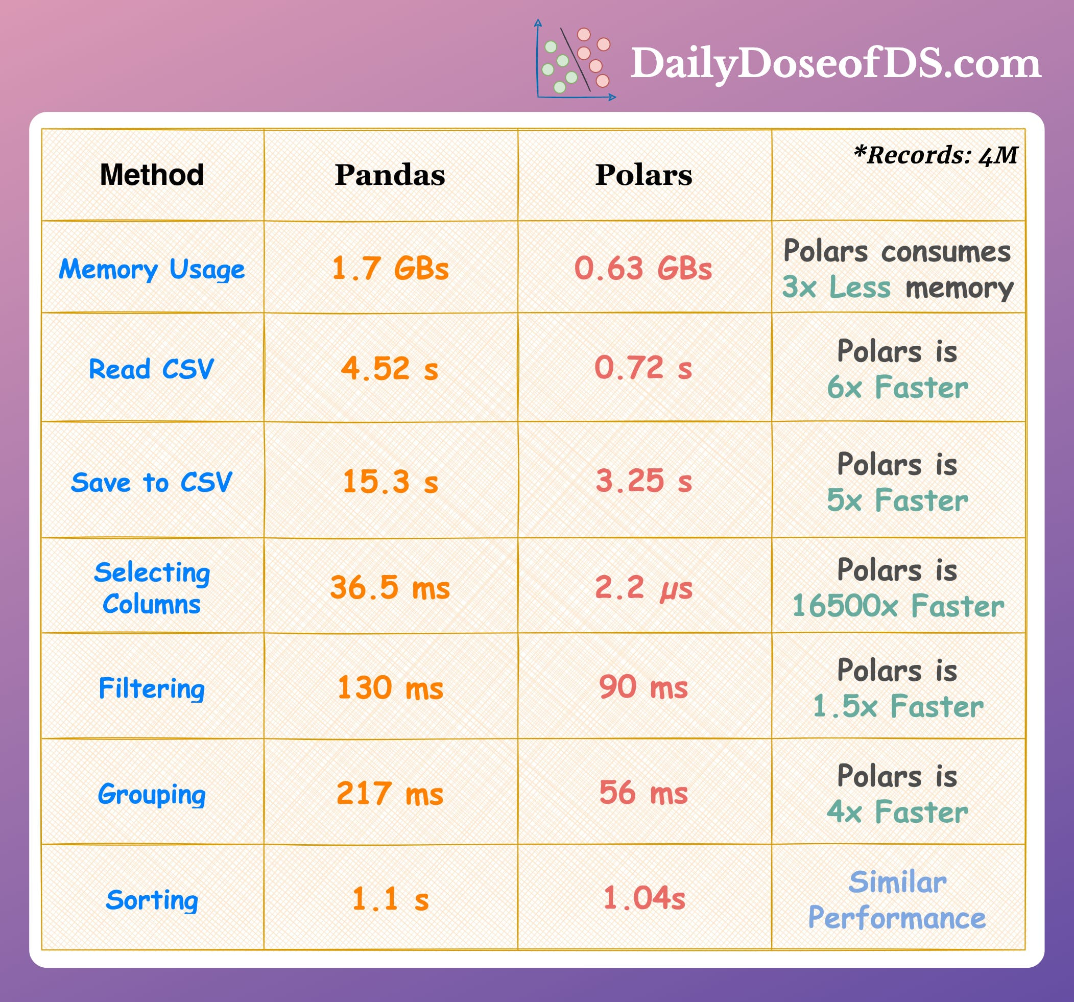
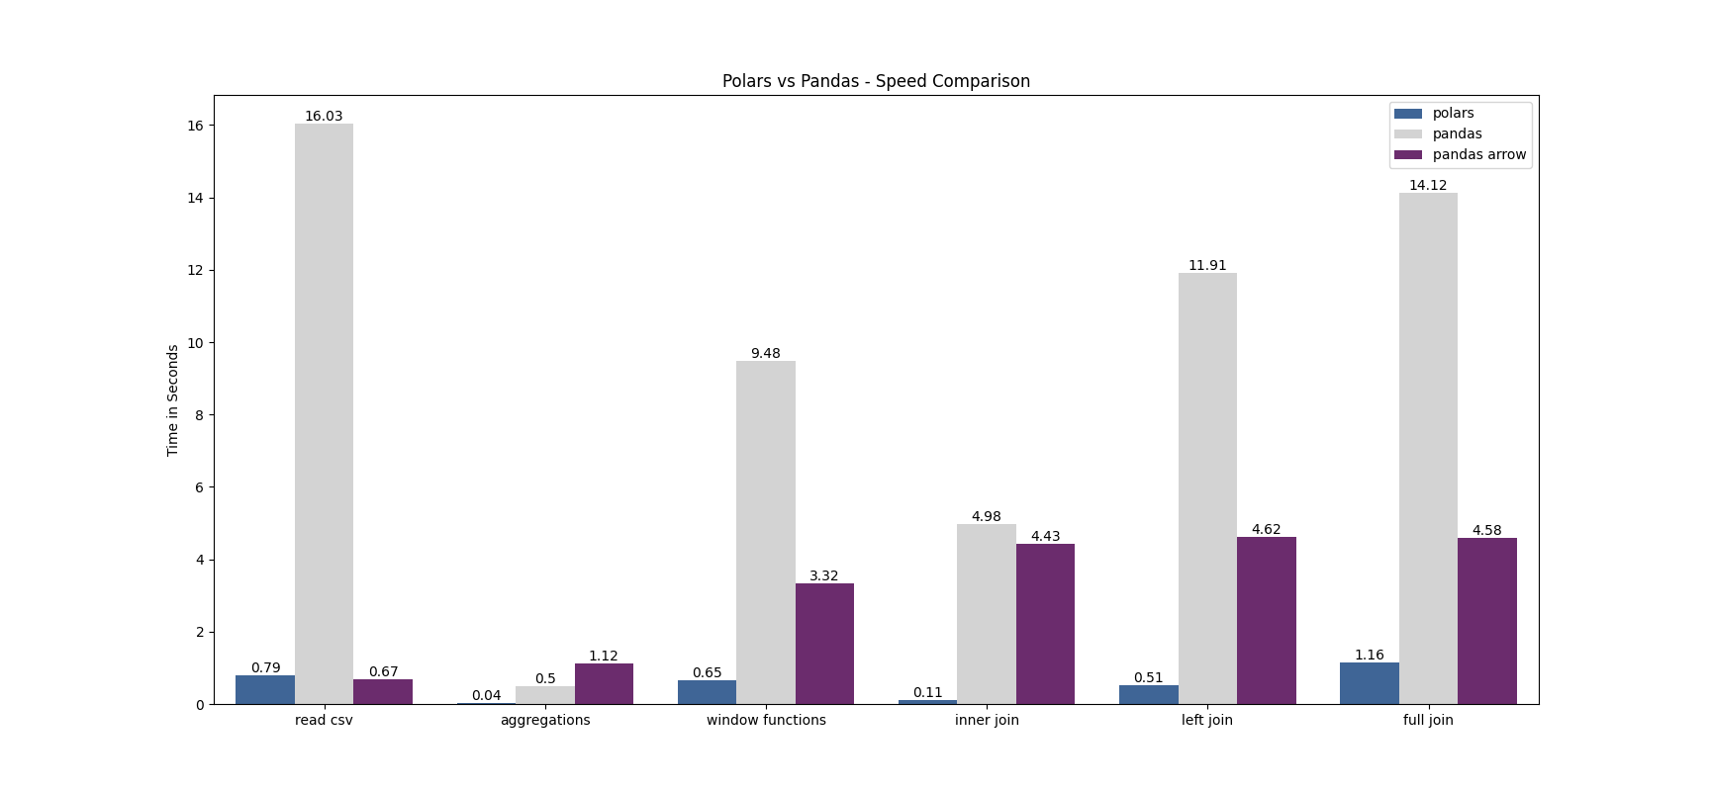
Proposed migration to Polars
Advantages of moving to Polars
  Speed, a lot shorter computation time for parsing the data
    It will adversely speedup the computation time for parsing the information into the database
  RAM consumption, previously we have highlighted this issue, although it was semi-fixed by constantly deleting the variables not needed
    Migrating to this will provide more RAM overhead

Slide 4
Just to show some numbers and testing
Even though its just a few seconds, with the amount of data we are working, the time savings will be decent.

Slide 5
Graphs that we are able to produce
Quality Score distribution
FAR, FRR graphs

Slide 6
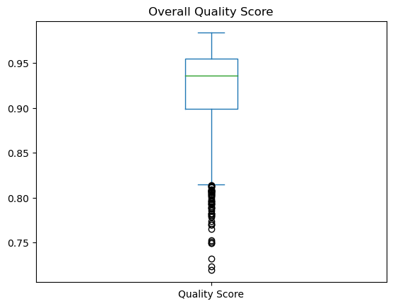
Quality Score Distribution

Slide 7
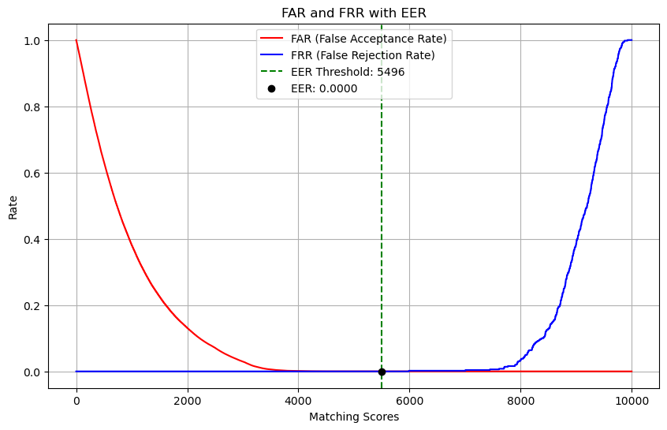
FAR and FRR Curve

Slide 8
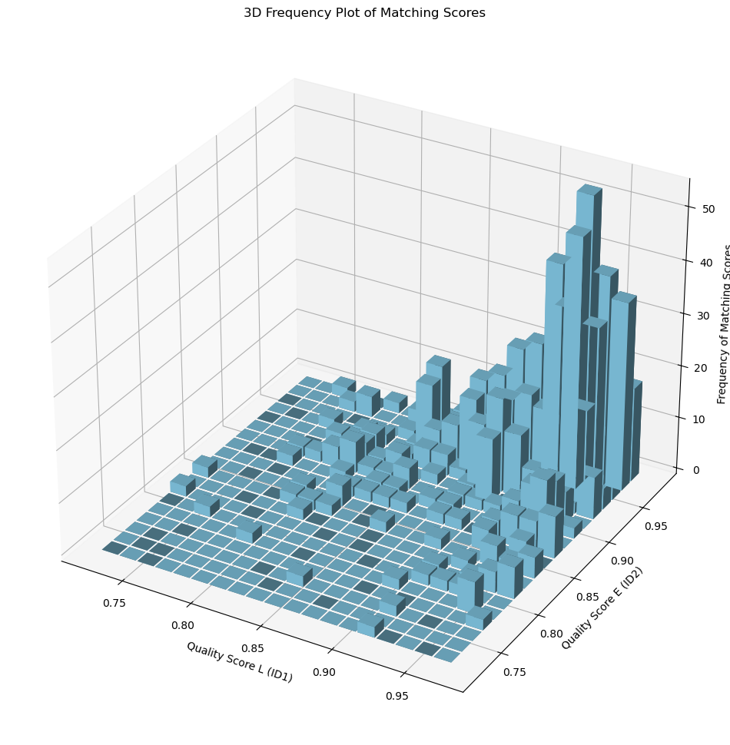
Quality Score 3D distribution

Slide 9
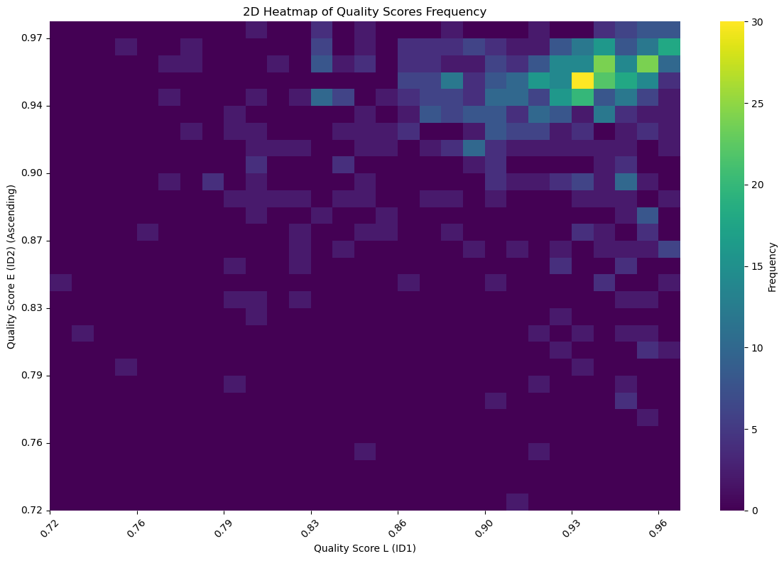
2D Heatmap of Quality Scores

Slide 10
How do we use the information from Quality Scores?
Example from Patrick Grother¹

Slide 11
Proposition
We are tailing the end of the testing phase where we have tested the codes and they are working to parse M:N = 12,000
The codes are ready to move into production stage
However, would like to launch a separate track to migrate the code in Pandas into Polar.
  Therefore, there will be 2 versions of the code, one running in Pandas and the other in Polar
  Subsequent downstream analysis, Polars will be used instead due to speed and time.

Slide 12
Table of Contents
Different folders in the Repository
What has been done for the backend?
Some case studies and examples for more complex
  Merging of 2 different data frames for storage savings
  Ranking for FPIR and FNIR
Overall progress for 1:1
Things that needs to be done for 1:1
Overall timeline

Slide 13
What are the different folders for?
Source_codes
  These are compiled source codes that are working. (Completed Features)
  This can contain codes that are not being used in the production as they may still be pending implementation (see section 6)
Resources
  These are resources (raw data, etc.) for the program
Build
  This is for the app/docker development
  Tentatively putting this on hold
Data_Cleanup
  This portion is similar to “2.resources: just that the data was cleaned up and sorted neatly for data usage.
Documentation
  This portion is just to document what was being done and for what purposes. Working to get this done so that people on board will be able to get started quickly.

Slide 14
What are the different folders for? Cont.
Test_scripts
  This section is for you to try out scripts like a working copy of a function, it may or may not necessarily work
  There is a subsection called implementation, this is for you to merge the test scripts and modify it to work the way you want it to work
Production
  These are the finalized codes that will be working

Slide 15
What was being done at the backend?
Accessing the database through a password.txt file
Parsing the information for ID1, ID2 and matching score
Moving the parsed information into a database table
Merging the data using matching score and demographic reference table
Computing ranking based on the threshold
Filtering
  Filter based on ID range or Matching score range or specific case

Slide 16
4. Merging the data using matching score and demographic reference table
Currently, we have to script to merge the information from the 2 tables
  A: Matching score without demographics
  B: Demographic information from the individuals
Previously, we have used mock data, ZZZZ matching score, etc.
With open source data and NEC’s result string, we are able validate that our code works
ID1 | ID2 | Matching Score
ID | Age | Gender | Country Code | Race*
*Race will not be collected, leaving it here due to code pending change

Slide 17
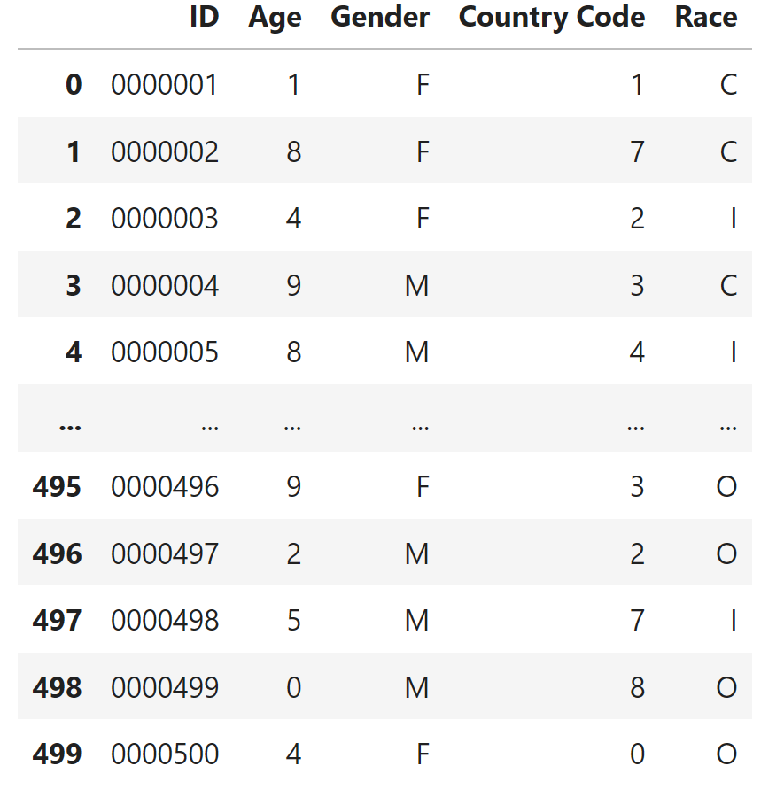
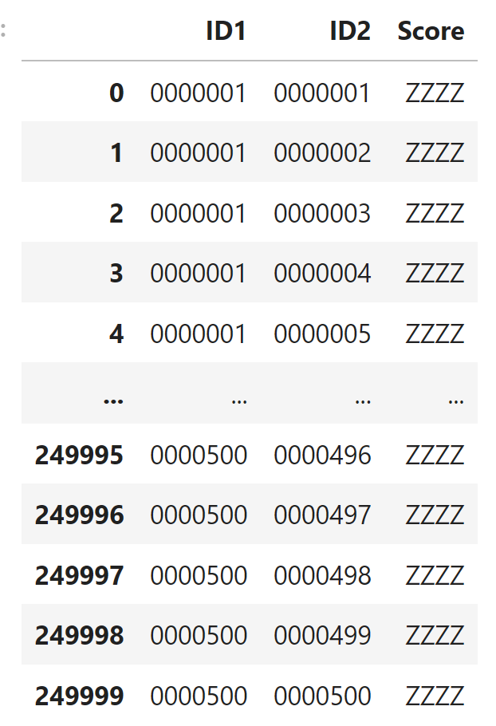
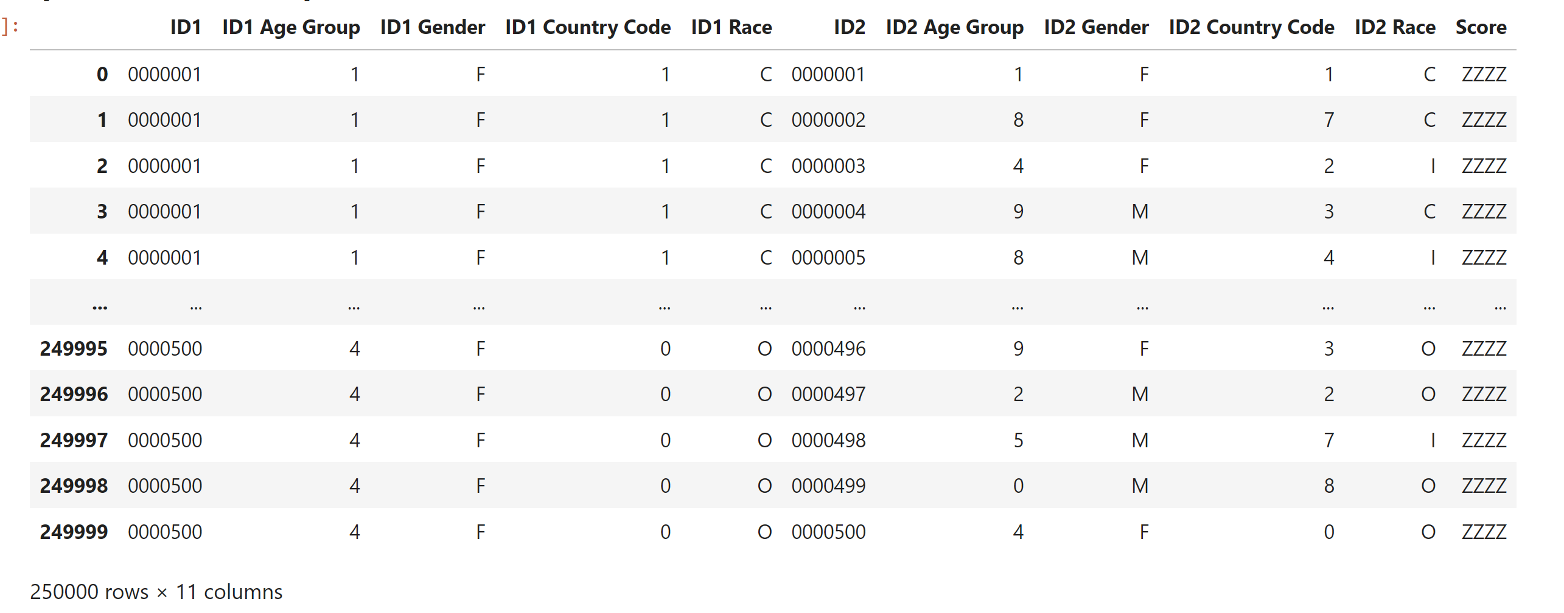

Slide 18
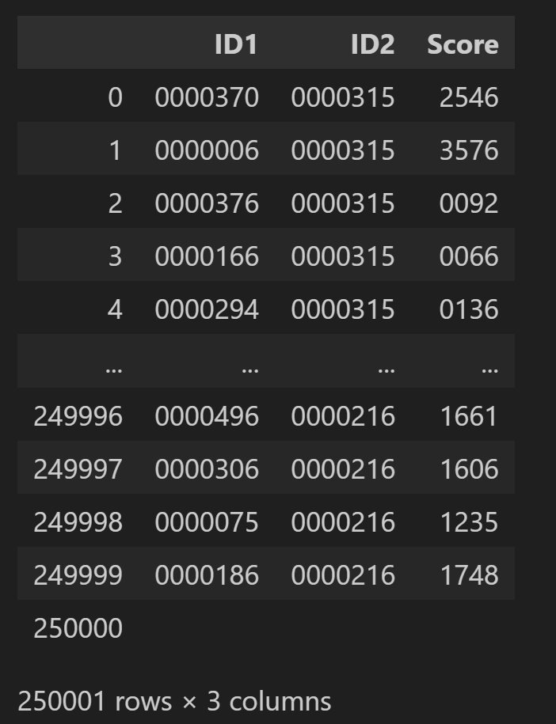
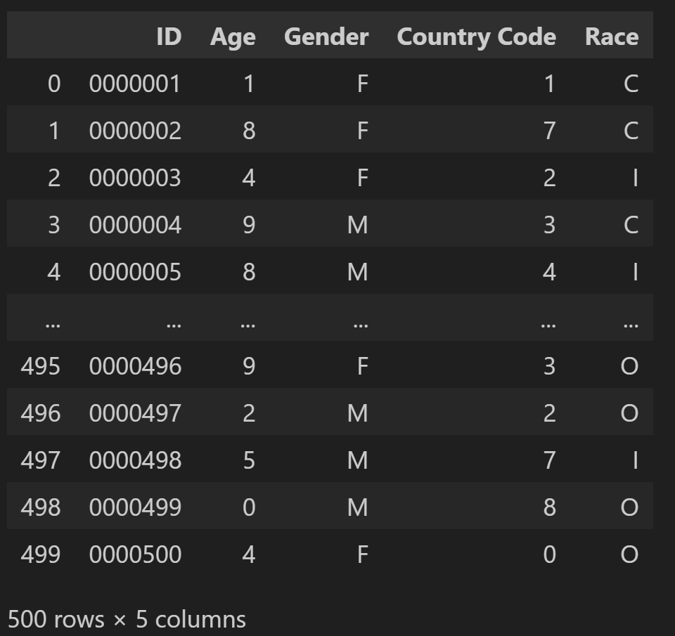
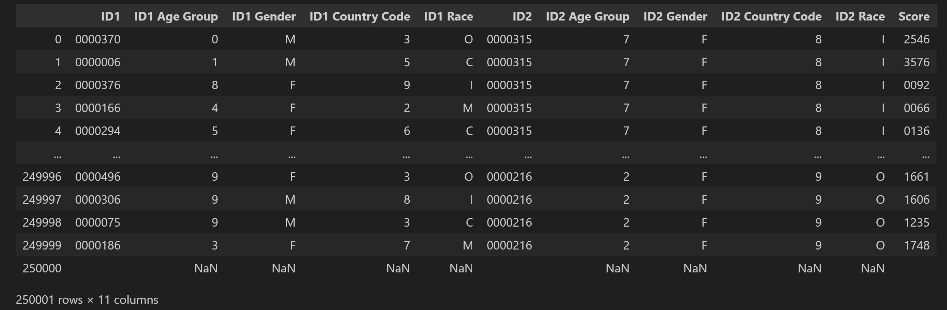

Slide 19
4. Merging the data using matching score and demographic reference table cont.
ID1 | Age 1 | Gender 1 | CC 1 | Race 1* | ID2 | Age 2 | Gender 2 | CC 2 | Race 2* | Matching Score
*Race will not be collected, leaving it here due to code pending change and testing

Slide 20
5. Computing ranking based on the threshold
With the threshold, we are able to calculate FPIR and FNIR
  FPIR: False Positive Identification Rate
  FNIR: False Negative Identification Rate
  Zero for both means that the system is the best
Sets a threshold, then computes genuine and imposter matches
Non-mated score above the threshold will count as a false positive (FPIR)
Mated score below the threshold will count as a false negative (FNIR)

Slide 21
Our Progress for 1:1 study
Formulation
Mostly done
Testing
Concepts
Mostly Done
Implementation
Halfway Done
Production
Not started yet
We need to test parsing and DB RAM usage

Slide 22
Timeline
Jan 25:
Feb 25:
Mar 25:
Cleanup of repository
Production for 1:1 analysis
Implementation and testing
Apr 25:
Data Migration and Matching 2
Data Migration and Matching 1

Slide 23
Work in Progress
Filename extraction for demographic information
Migration to Panther Desktop
  Setup DB/Copy the DB over to Panther
  Python Environment on Panther
Merging of Dataframes for multiple filenames
Implementing RAM Fix codes
Merging of all the necessary functionalities into implementation test script

Slide 24
Work in progress
Script for generating a reference table from the images provided (see below)
ID1 | Age Group | Gender | Country Code | Modality
 |  |  |  | Enrolled, etc Face, Left/Right Iris.
One of the reasons why we are doing this is to conserve space usage.
We also have the ability to reconstruct the information as per previous slides

Slide 25
Future Work in Consideration
Docker environment to host the code and libraries required for the application
Dockerization of the Database environment
Implementing much more flexible scripts that allow user inputs for length of ID fields, matching score fields, etc.
  More use cases for other B&P projects
  Provides an all in one analytics platform
  More analytics studies can leverage on this platform

Slide 26
Documentation
Please see section on documentation for the detailed description of the different functionalities being implemented.
This is still a work in progress just to ensure that the codes are properly documented for reference.
  Most of the documentation is done on the code itself
  Will spend some time to do the documentation once the code has been put into the production phase

